Slide 1
Advanced Internet Computing
WS 2013/14
Topic 2: Crowdsourcing
Bernhard Gößwein
David Riepl
Robert Kapeller
Notes:
Vorstellung des Themas und der Referenten.

Slide 2
Topic description
Plan and implement Sentiment analysis for products and companies mentioned in article-feeds
  Gather feed-contents
  Crowd: Identify keywords for products and/or companies
  Crowd: Rate keywords in conjunction with article
  REST interface for sentiment querying
Implement Crowd sourcing simulator
  (MobileWorks was not reliable...)
Notes:
Kurzer Überblick über Inhalt.

Slide 3
Technology
Python
Django
  REST / JSON / Tastypie / ...
Feedparser
SQLLite
Bootstrap (for GUI, mockups)
Notes:
Kurzer Überblick über Inhalt.

Slide 4
Our solution
2 Tasks
  Identify keywords
    Feed-fetch automated via cron jobs (yahoo finance)
  Rate keywords
    Customer driven (Order)
    Task-count depend on customer budget and article length
Sentiment analysis (graphically)
  Average sentiment per keyword
  Detailed view
  Graphical analysis
GC
  Delete old unfinished tasks
Notes:
Kurzer Überblick über Inhalt.

Slide 5
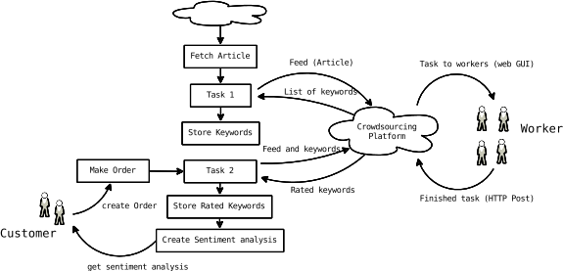
Task flow
Notes:
Kurzer Überblick über Inhalt.

Slide 6
Quality control
Task 1 – keyword detection
  Worker rated with negatively if:
    keyword not in original text (currently no word - normalization). Word not accepted.
    Majority voting on keyword/category combination
Task 2- sentiment voting
  Spam-prevention: if distance to median >= 3 worker rated negatively
Currently no way to earn „plus“-points
Currently no effect on analysis (input of each worker is accepted)
Notes:
Kurzer Überblick über Inhalt.

Slide 7
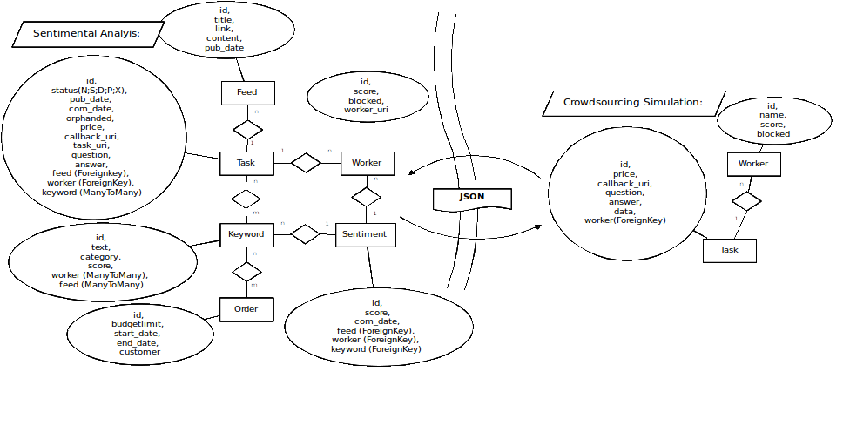
DB Model
Notes:
Kurzer Überblick über Inhalt.

Slide 8
Thank you
Thank you!
Now lets see it in action!
Notes:
Kurzer Überblick über Inhalt.

